Slide 1

Presented by ADELANWA OGUNLOLU
Streamline Logistics Solutions
Delivery Performance Dashboard

Slide 2
Agenda
Business overview
Business challenges
Key performance index
Delivery Performance Dashboard
Insights and recommendations
Thank you

Slide 3
Business Overview
Streamline Logistics Solutions is a distinguished and growing leader in the supply chain and logistics industry since 2023. Known for reliability and efficiency, the company provides expert nationwide logistics services, consistently maintaining high standards of service excellence. Streamline optimizes transportation processes and delivery performance by offering tailored solutions designed to reduce operational costs. We are committed to operational efficiency and customer satisfaction.

Slide 4
Business Challenges

Slide 5
Key Performance Index
Orders: 1,500,
Avg delivery time: 152 min
Avg delay time: 14.5 min
Delivery efficiency: 90.5%
Negative feedback: 35%
Insights:
Delivery Time: 152 minutes exceeds optimal thresholds for urban logistics.
Delay Time: 14.5 minutes suggests recurring route or dispatch inefficiencies.
Negative Feedback: 35% is significantly high likely tied to delays and missed expectations. This may reduce repeat orders and brand trust.
Efficiency: 90.5% is good, but not optimal — room for improvement in route planning and driver load balancing.

Slide 6
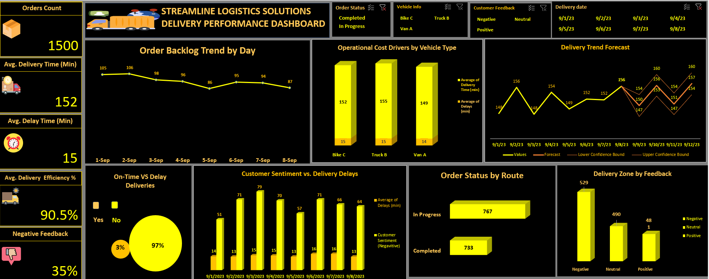

Slide 7
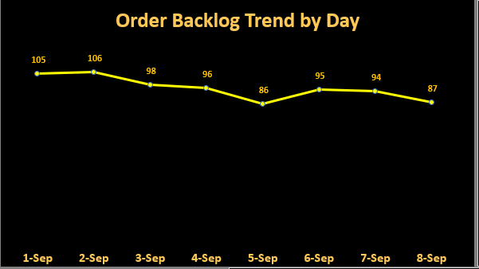
Insights
Backlog peaked at 106 on 2-Sep then trended downward to 86 by 5-Sep, showing a net reduction in pending orders early in the week
A small rebound occurs on 6-Sep (95) before declining again to 87 on 8-Sep, indicating intermittent recovery but overall downward momentum
Daily backlog remains above 85 orders — indicating unresolved volume or process inefficiencies
Recommendations
Set daily backlog threshold target: ≤ 50 orders/day within 30 days.
Prioritize aging orders for immediate resolution using Excel filters and conditional formatting.
Use Excel’s COUNTIFS and DATEDIF to flag orders pending beyond SLA.
Build Excel dashboard with slicers for backlog by route, driver, and order age.
Use line charts and trendlines to visualize backlog momentum and forecast clearance.

Slide 8
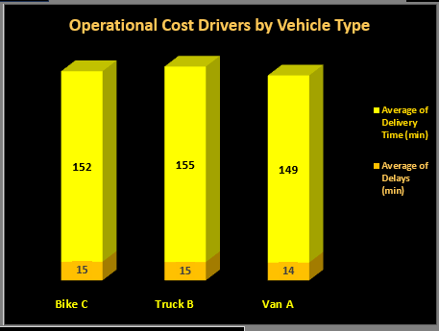
Insights
Avg delivery times vary by vehicle: Truck B is highest (155 min), Bike C mid (152 min), Van A lowest (149 min), indicating vehicle choice impacts route duration
Avg delays are similar across vehicle types (≈14 – 15n min), so longer delivery times for trucks are not accompanied by proportionally higher delays
Recommendations
Prioritize Van A for short-haul and urban deliveries due to lower delivery and delay times
Reassign Truck B to consolidated, long-haul routes where delivery time is less sensitive
Limit Bike C usage to low-density zones or off-peak hours to reduce delay exposure
Explore hybrid delivery models (e.g., bike + van relay) for congested zones

Slide 9
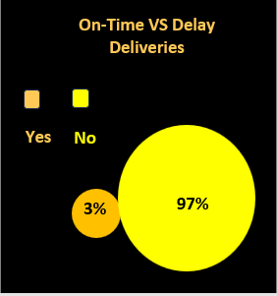
Insights
.
Only 3% of deliveries were on time this is a major operational concern.
97% of deliveries were delayed, indicating systemic inefficiencies across routes and dispatch.
High delay rate likely correlates with elevated negative feedback and reduced trust.
Such a high delay percentage suggests issues in routing, driver performance, traffic forecasting, or dispatch timing
Recommendations
Conduct root cause analysis on delay sources: route congestion, driver load, dispatch timing, and address quality.
Implement dynamic routing with real-time traffic data and predictive ETAs.
Introduce staggered dispatch windows to reduce peak-hour congestion.
Set daily delay thresholds and alert triggers for operations team.

Slide 10
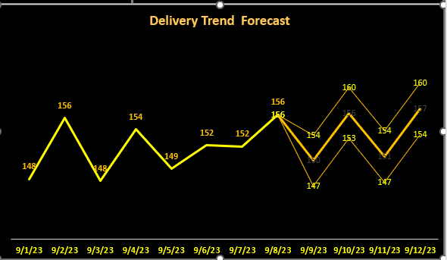
Insights
.
Daily deliveries ranged from 148 to 156, showing consistent throughput before forecasting began. Forecasted deliveries closely align with actuals, validating model accuracy.
Forecast predicts sustained volume between 154 and 160, indicating expected demand stability.
Sept 12 reached 160 deliveries, the highest in the period potential surge or optimized routing.
Forecast Accuracy
Recommendations
Use forecast data to pre-allocate drivers, vehicles, and routes for high-volume days.
Align staffing and dispatch schedules with forecasted peaks (e.g., Sept 11).
Investigate Sept 11 operations to replicate successful routing and load balancing.
Address low-volume days (e.g., Sept 10) with flexible capacity or promotional incentives.
Continue refining forecasting algorithms using historical delivery patterns and external factors (weather, traffic).

Slide 11
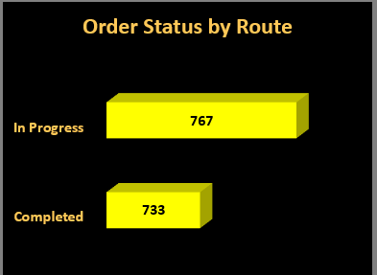
Insights
.
767 orders are still in progress, exceeding the number of completed orders (733).
The difference of 34 orders suggests a backlog or delay in finalizing deliveries.
Routes may be unevenly distributed or facing bottlenecks that slow down completion rates.
High in-progress volume could lead to missed delivery windows and increased customer dissatisfaction.
Recommendations
Reassign high-load routes to balance delivery volume and reduce in-progress backlog.
Implement escalation protocols for orders pending beyond SLA thresholds.
Track order status by route and driver daily to identify lagging zones.
Set completion rate targets and monitor progress with dashboard KPIs.
Prioritize aging in-progress orders for immediate resolution.

Slide 12
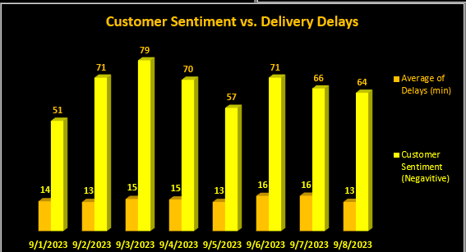
Insights
.
Average delivery delays range from 51 to 79 minutes, well above acceptable thresholds.
Delay reached 79 minutes, with 15 negative sentiment reports highest combined impact.
Daily negative feedback remains steady between 13 and 16, indicating persistent customer dissatisfaction.
Days with higher delays (Sept 3, 4, 6) align with spikes in negative sentiment, confirming delivery time as a key driver of customer experience.
•
Recommendations
Set target to reduce average delivery delay to ≤ 30 minutes within 30 days.
Investigate root causes of peak delay days (e.g., Sept 3, 4, 6) — route congestion, staffing, dispatch timing.
Introduce dynamic routing and real-time traffic alerts to improve delivery speed.
Launch proactive communication for delayed deliveries (ETA updates, apology messages).
Implement service recovery policies: auto-credit, priority redelivery, or loyalty incentives.

Slide 13
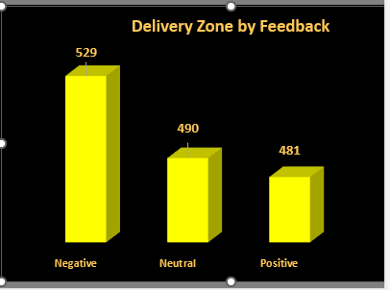
Insights
.
Negative feedback is largest segment (529), slightly higher than Neutral (490) and Positive (481), indicating overall sentiment skews negative
The distribution is relatively balanced across categories, but the negative category being highest signals an opportunity to reduce issues driving complaints
Negative feedback exceeds Positive by 48 responses, revealing a perception gap in service quality.
Recommendations
Launch targeted service recovery programs in zones with high negative feedback.
Introduce post-delivery follow-ups and satisfaction surveys to capture real-time sentiment.
Analyze top drivers of negative feedback (e.g., delays, missed ETAs, poor communication).
Implement SOPs for high-risk zones to improve consistency and responsiveness.
Incentivize drivers and teams in zones with rising positive feedback.

Slide 14


